Slide 1
3D-PRINTING TECHNOLOGY
GUIDE: D.V.SRIKANTH
BY N. MANISH REDDY(13K81A03A3) R.KALYAN(13K81A03A9) N.RAVINDER REDDY(13K81A03A4) K.TIRUMALA(13K81A0390)

Slide 2
MANUFACTURING PROCESS
Traditional Manufacturing - Removing material
Ex. Turning , Milling , Drilling ....
Additive Manufacturing - Adding layer-upon-layer of material
Ex.Stereolithography(SLA),FusedDeposition Modelling(FDM-3D-Printing)

Slide 3
TRADITIONAL VS ADDITIVE
Traditional engineering
shipping cost is high
It takes more time
creates more waste
Cannot create more complex models So, By using 3D-PRINTING(Additive) technology we can solve these problems.

Slide 4

WHAT IS 3D PRINTING?

Slide 5
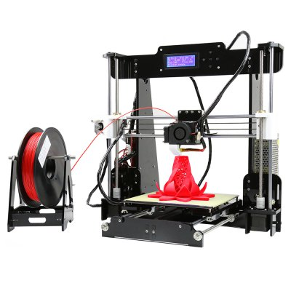
3D-printing or additive manufacturing
building up solid objects layer by layer

Slide 6
PROCEDURE FOR PRINTING
Designing using CAD
Save into .stl file format
Repetier-Host software
Inputs like temperature,layer thickness
Slicing
Design is saved for sd print or usb print
Model is ready to print

Slide 7
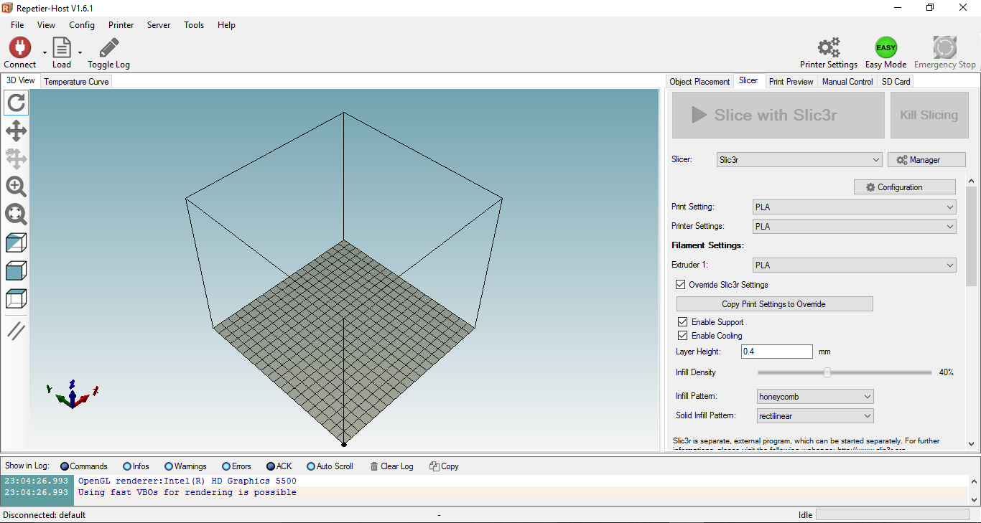
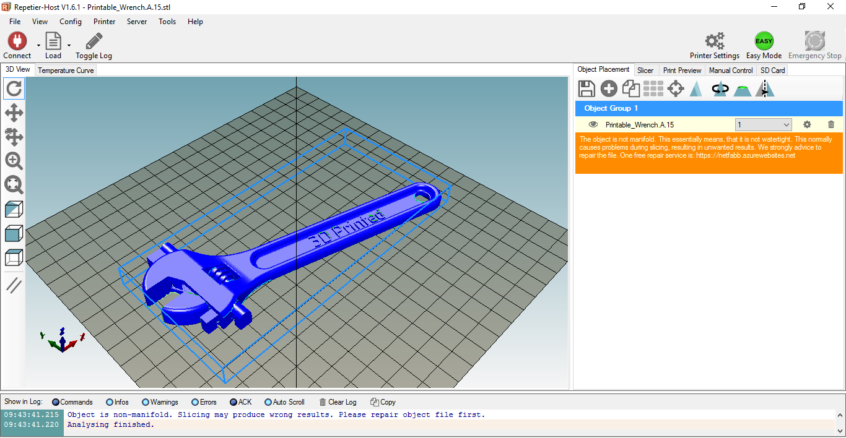
REPETIER HOST-SOFTWARE

Slide 8
3D PRINTER

Slide 9
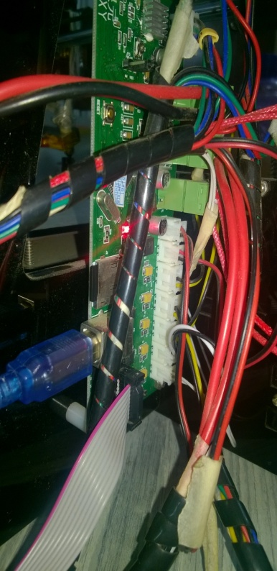
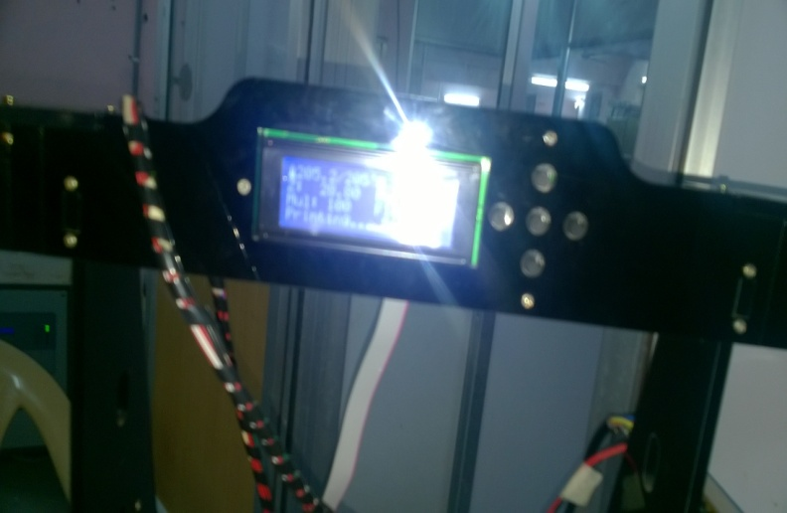
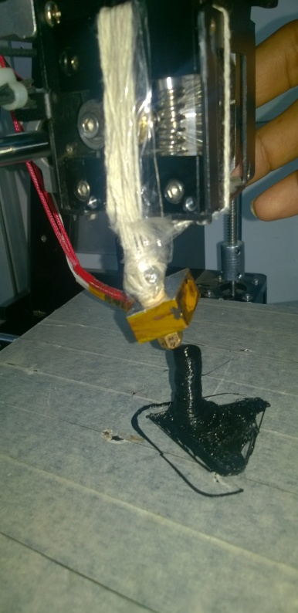
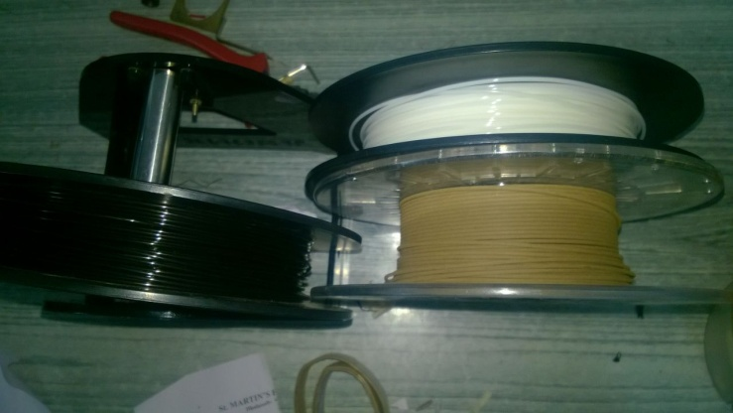
VARIOUS PARTS
DISPLAY
MEMORY CARD SLOT
EXTRUDE WITH
NOZZLE
FILAMENTS

Slide 10
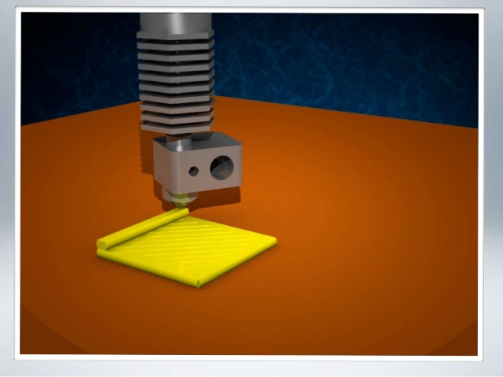
LAYER BY LAYER FORMATION

Slide 11
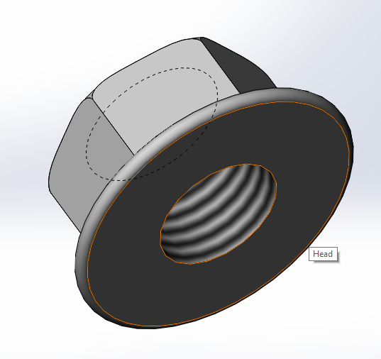
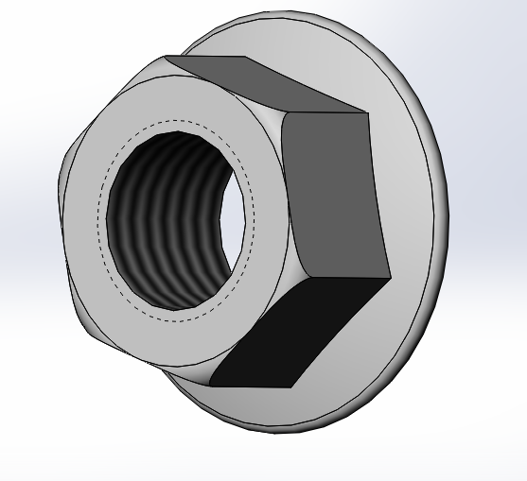
MODEL
NUT

Slide 12
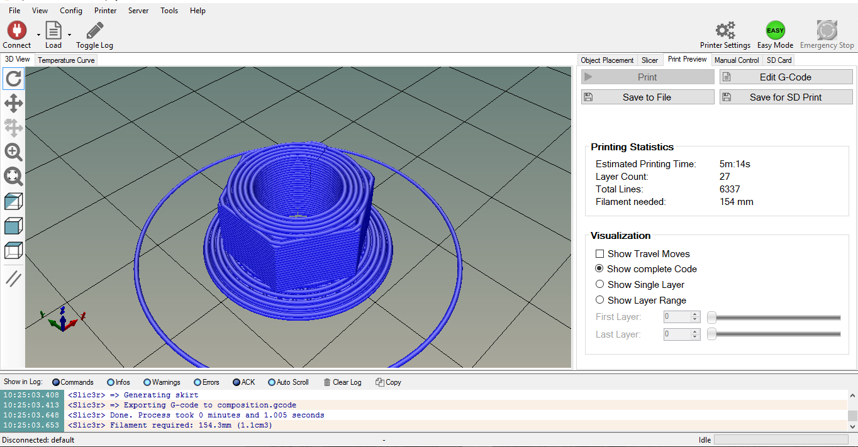
SLICING PROCESS IN REPETIER HOST

Slide 13
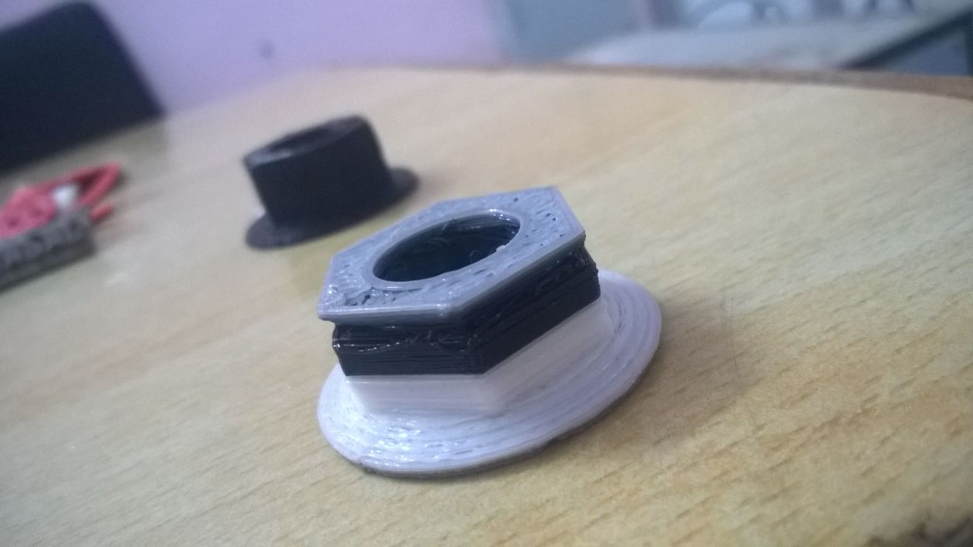
AFTER PRINTING
Printing done with two colors

Slide 14
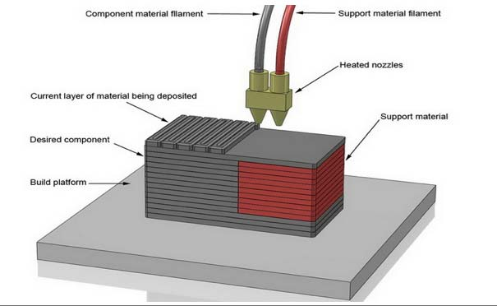
MODIFICATION
DUAL EXTRUDER(DOUBLE-NOZZLE)

Slide 15
DUAL EXTRUDER (Double Nozzle)
Printing with multiple filaments.
Contains two nozzles
STEPS TO BE CARRIED
Importing same as single extruder
Changing the tempetures
Changing the number of extruders
Two extruders position to bed
Colours to be assigned

Slide 16
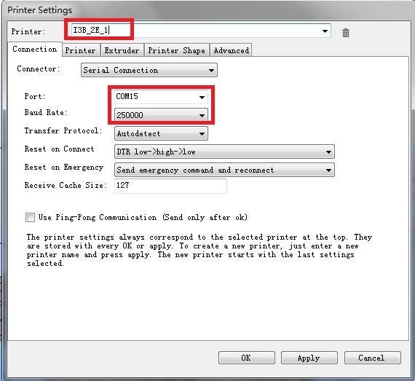
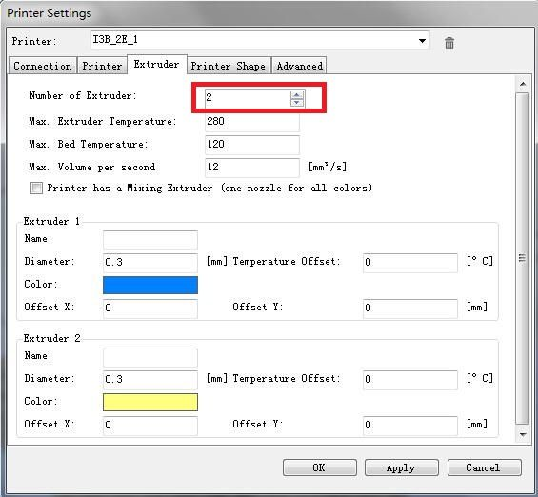
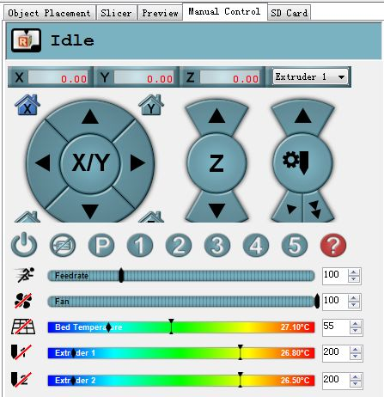
DUAL EXTRUDER SETUP

Slide 17
SINGLE VS DUAL EXTRUDER
Single Extruder prints only colour.
Dual Extruder prints colours
Single Extruder uses only one filament.
Dual Extruder uses two filaments one main and other supporting and can print complex shapes like overhanging.

Slide 18
APPLICATIONS OF 3D PRINTER
Food industry
Medical applications
Prototyping/CAD
Architecture
Mass customization
Automobile industry

Slide 19
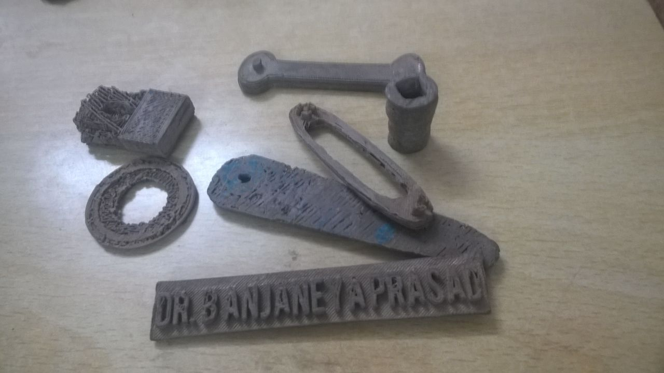
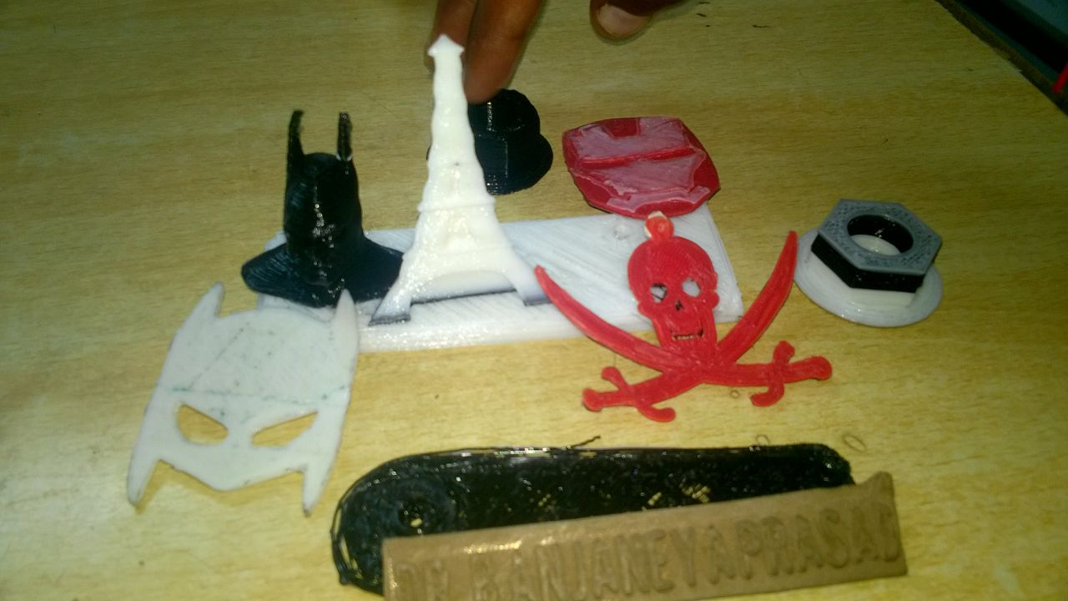
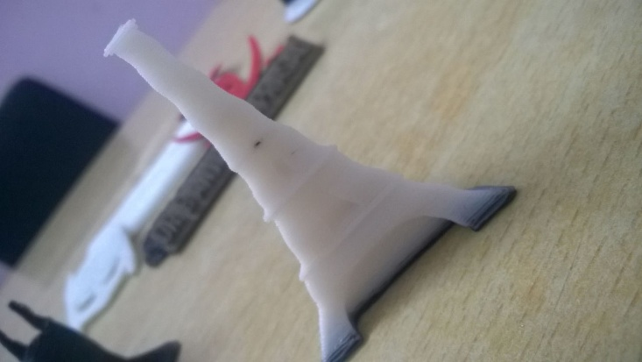
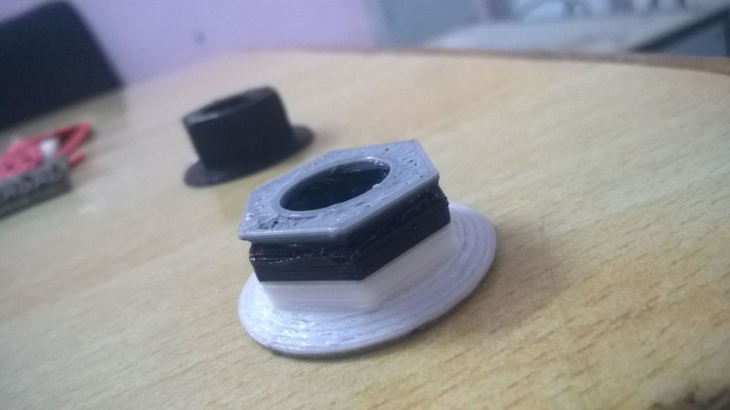
MODELS WE DID
Various Metallic Models
Various plastic Models
Eiffel tower
Nut with dual Colour

Slide 20

THANK YOU
ANY QUERIES?

